Slide 1
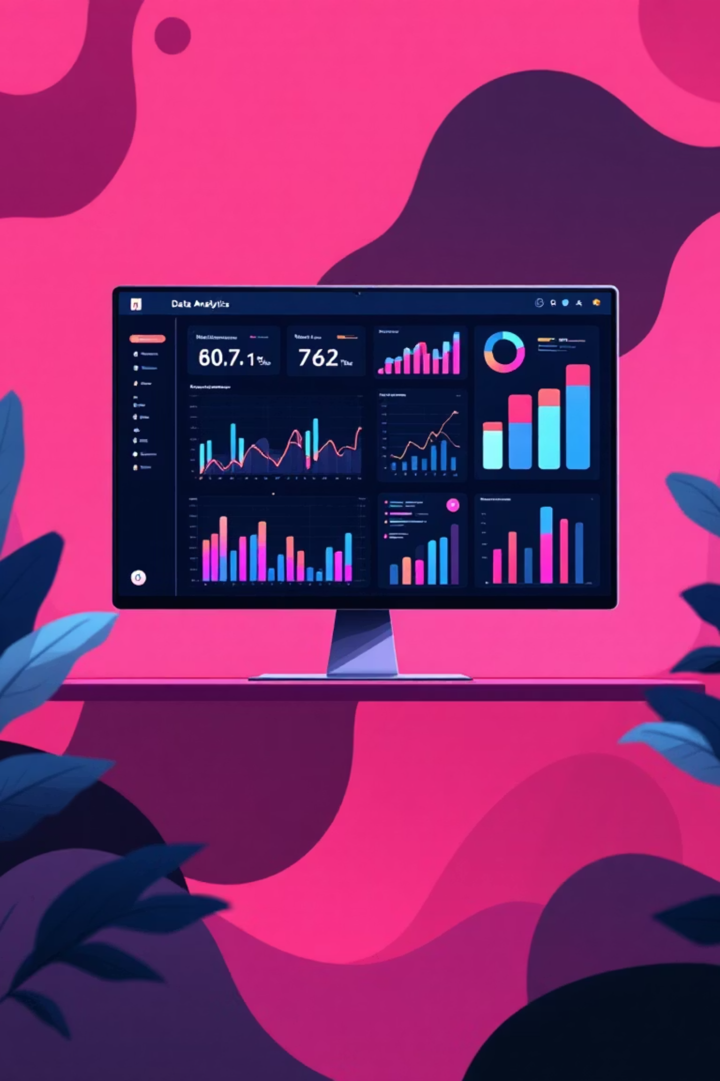

Customer Shopping Trends & Segmentation Analysis
A complete data-driven analysis including SQL insights, Power BI dashboards, and customer clustering
Project ID: CDACL-002 | Team ID: PTID-CDA-NOV-25-884 | Type: Client Project |
Analyst: Sainanthan, Thirumurugan

Slide 2


Project Overview
This project analyzes customer shopping behavior using SQL and Power BI to uncover trends in spending, discounts, seasonal patterns, and location-based performance. It identifies product categories where discounts should be applied and examines how different age groups use various payment methods. Advanced clustering using Python groups customers into meaningful segments, enabling personalized and data-driven marketing strategies. The project also delivers interactive Power BI dashboards, actionable insights for business growth, and a clear segmentation model that supports targeted promotional planning and improved customer retention.
SQL Analysis
Deep data insights
Power BI
Visual storytelling
Python ML
Customer segments

Slide 3
Dataset Summary
3,900
11
1
Customer Records
Data Attributes
MySQL Database
Comprehensive shopping data analysed
Rich feature set for analysis
project_shopping_trends
Customer Demographics
Purchase Behaviour
Age groups
Purchase amount
Gender distribution
Product category
Location data
Payment method
Engagement Metrics
Temporal Patterns
Review ratings
Seasonal trends
Subscription status
Past purchases
Promo & discount usage
Shopping frequency

Slide 4
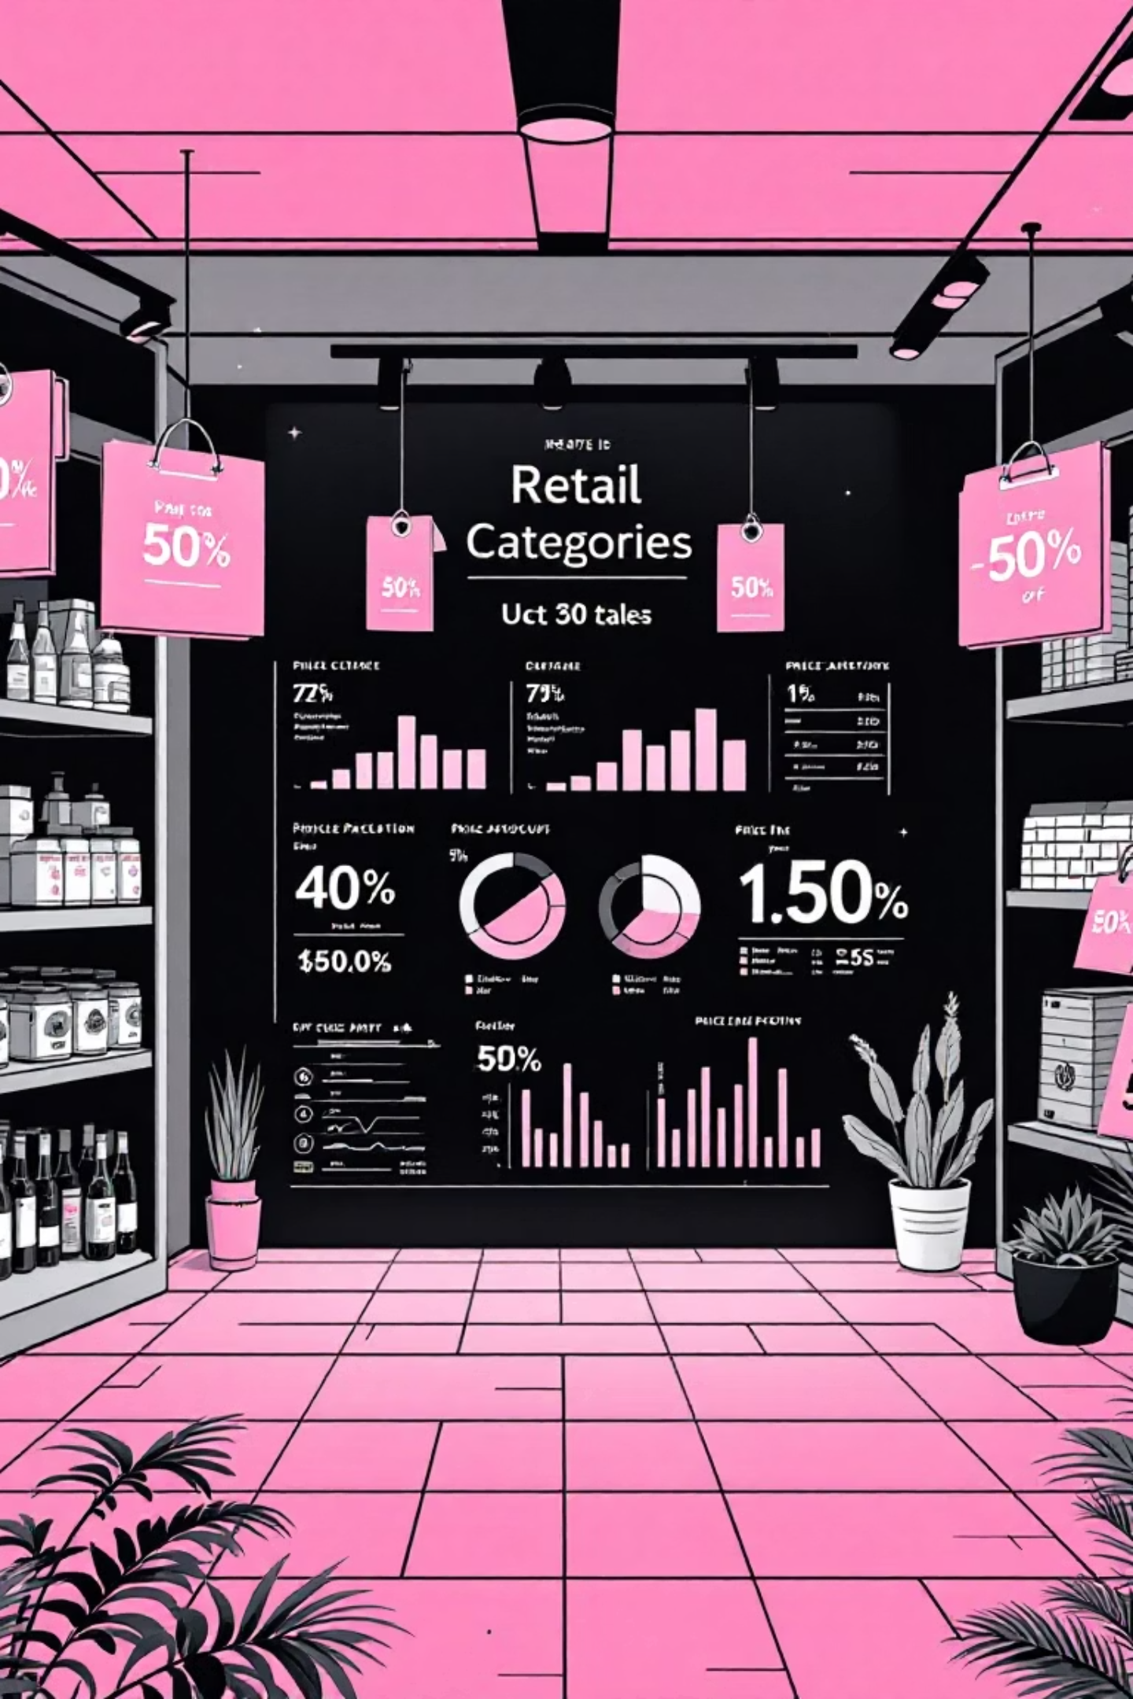
Product Category Discount Analysis
Identifying categories requiring strategic discount interventions to boost performance
Discount Usage by Category
Analysed discount application rates across all product categories to identify current promotional effectiveness
Category-Wise Performance
Evaluated total orders, average purchase value, and past purchase frequency for each category
Frequency of Discount vs Promo Usage
Identified categories with low average purchase amounts and revenue requiring discount strategies
Most Profitable vs Least Profitable Categories
Categories with minimal discount usage but strong potential show opportunity for targeted promotions

Slide 5
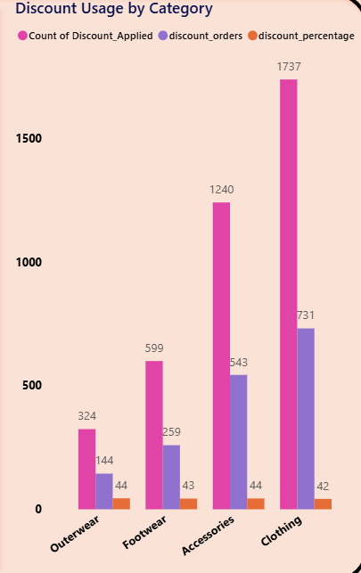
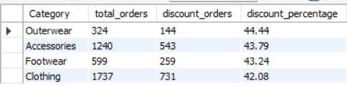

1.Discount Usage by Category
This query identifies how frequently discounts are applied across product categories. It helps highlight categories where customers consistently depend on discounts, indicating strong price sensitivity.

Slide 6
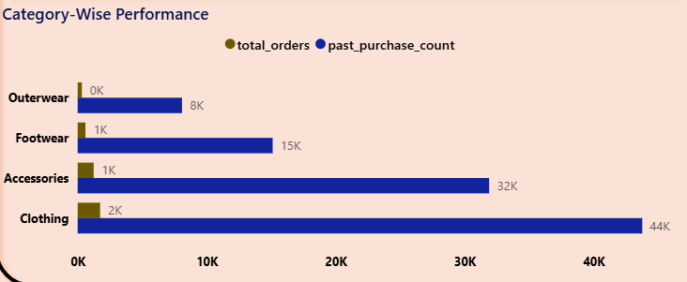
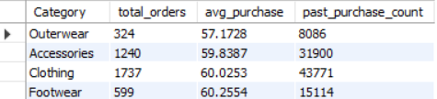
2.Category-Wise Performance (Sales Strength)
This query compares total orders, average purchase amount, and past purchase counts across categories, helping reveal low-performing categories that may require discount strategies to boost sales.

Slide 7
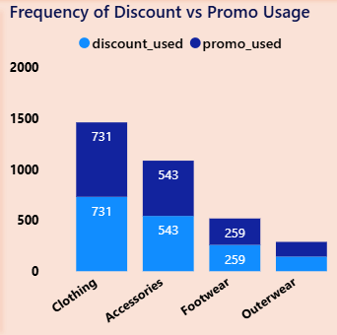
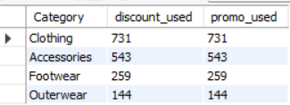
3.Frequency of Discount vs Promo Usage
This query measures how often customers use discounts versus promo codes within each category. It helps determine which categories respond more to promotional offers and which type of offer is more effective.

Slide 8
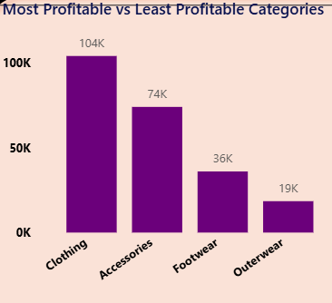
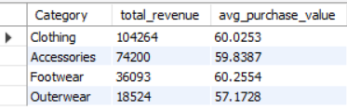
4.Most Profitable vs Least Profitable Categories
This query ranks categories based on total revenue and average purchase value. It helps identify top-performing segments that don't need discounts and weak-performing segments that may require targeted promotional support.

Slide 9
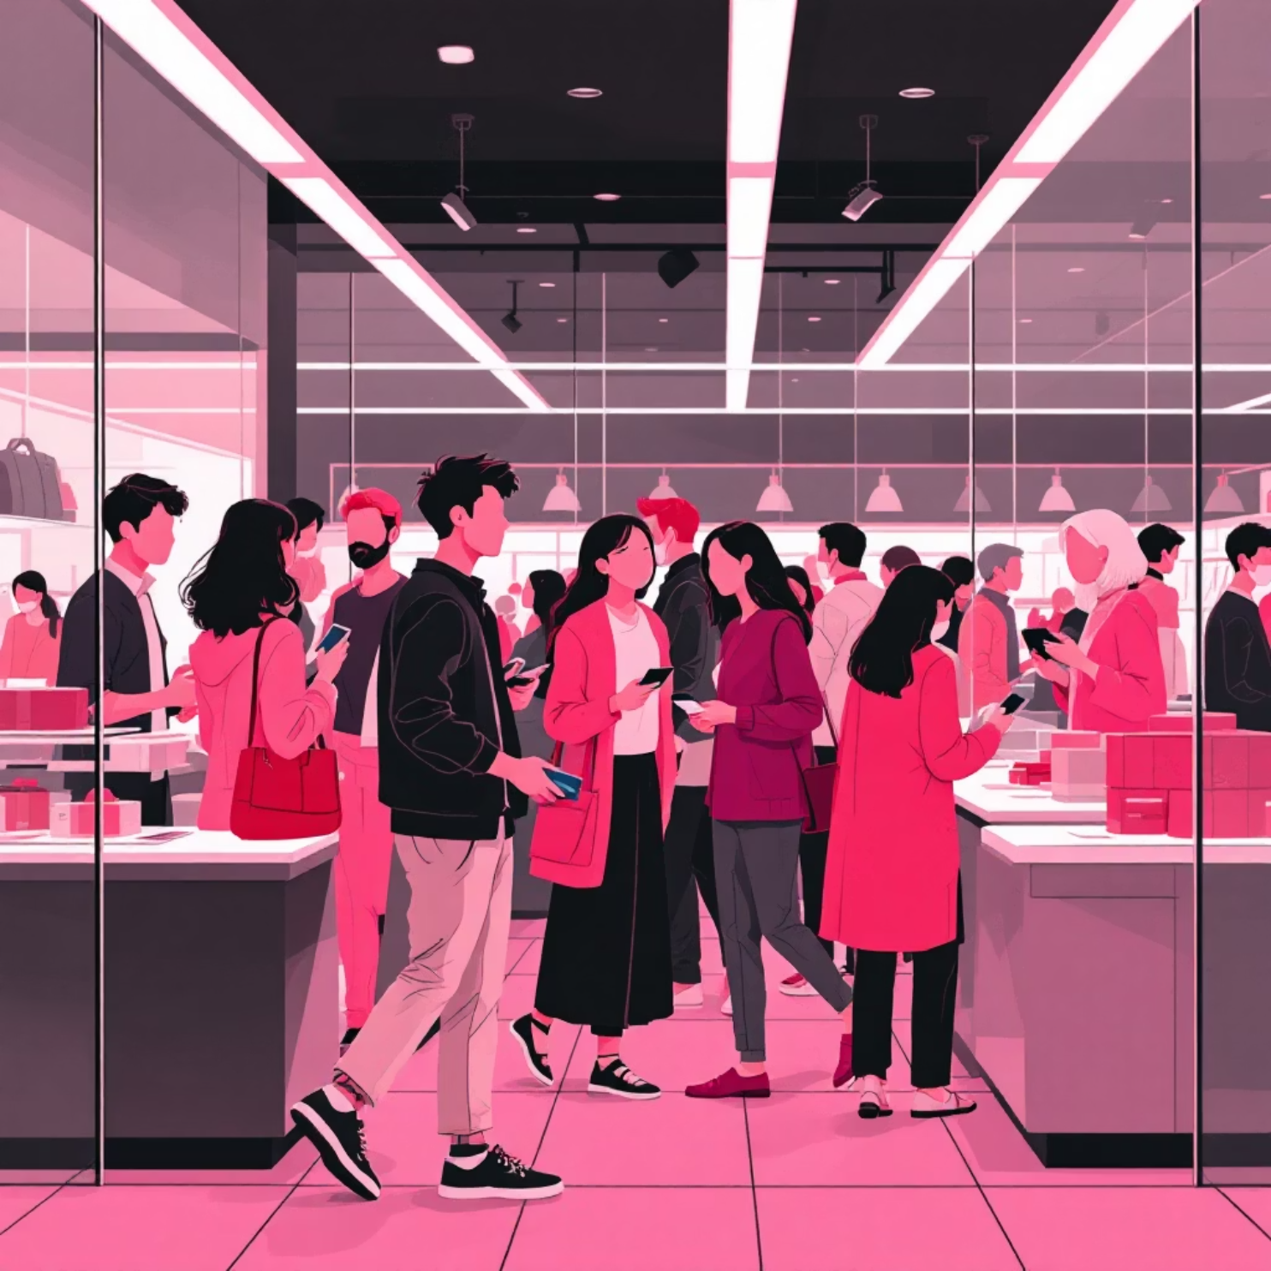
Age, Season & Location Spending Analysis
Card Spending Based on Age Groups
Age Group Total Spending
Season-wise Spending & Orders
Location-wise Revenue
Age × Season Spending Pattern

Slide 10
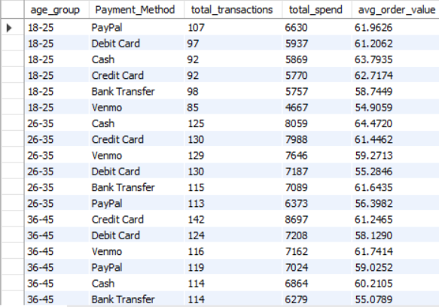
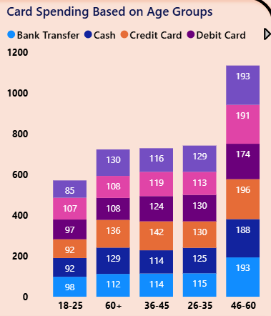
1.Card Spending Based on Age Groups
Examines how different age groups use various payment methods and how much they spend. This reveals the most valuable customer age segments and their payment preferences.

Slide 11
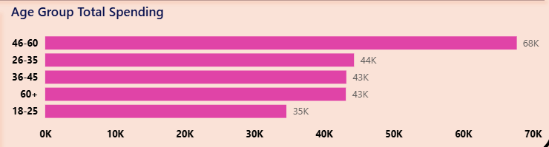
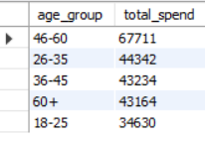
2.Age Group Total Spending
Calculates total spending for each age group to identify the demographic segments that contribute the highest revenue to the business

Slide 12
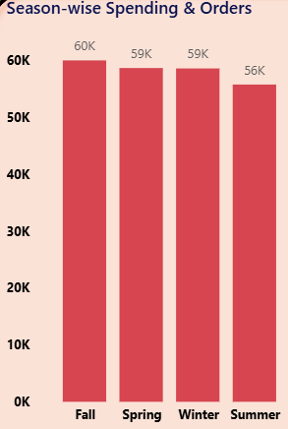
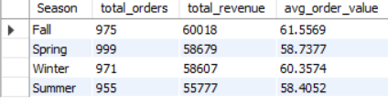
3.Season-wise Spending & Orders
Analyzes spending patterns across different seasons to determine high-demand and low-demand periods. Helps businesses plan seasonal promotions and inventory.

Slide 13
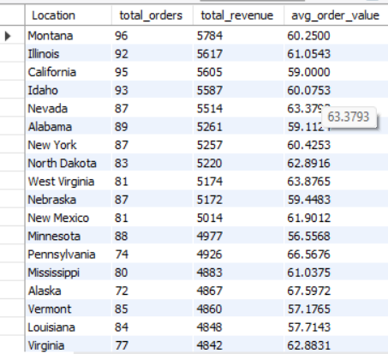
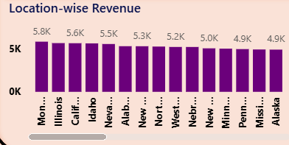
4. Location-wise Revenue
Evaluates total revenue generated across different geographic locations. Identifies high-performing and underperforming regions for targeted marketing and distribution decisions.

Slide 14
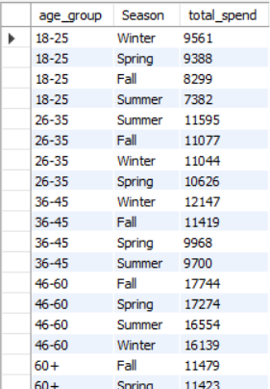
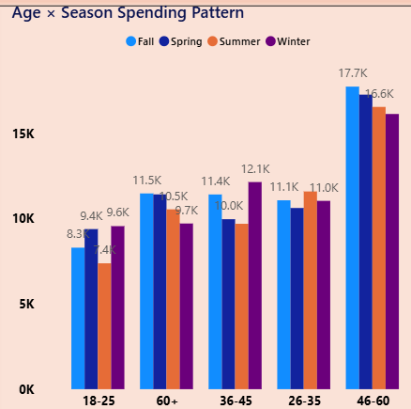
5.Age × Season Spending Pattern
Combines age groups and seasons to understand how seasonal trends vary across different age segments, enabling more precise seasonal marketing strategies.

Slide 15

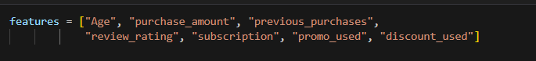
Customer Clustering with K-Means
Advanced Python machine learning to segment customers into actionable groups
01
Feature Selection
Key attributes: purchase amount, discount usage, promo codes, subscription status, and past purchases

Slide 16
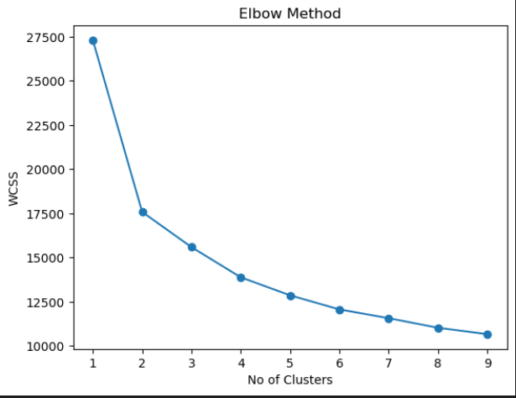
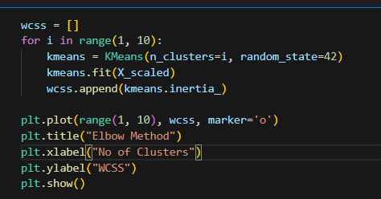
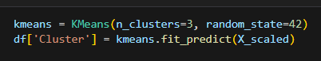
02
Elbow Method Analysis
Determined optimal cluster count by analysing within-cluster sum of squares across different K values
03
Three Clusters Identified
K=3 selected as optimal, balancing model complexity with meaningful customer differentiation

Slide 17

Customer Cluster Profiles
Cluster 0: Deal Seekers
Cluster 1: Full-Price Buyers
Behaviour: Heavy discount and promo code users, highly price-sensitive shoppers
Behaviour: No discount or promo usage, stable and consistent spenders
Strategy: Flash sales, limited-time offers, promo-driven advertising campaigns
Strategy: Premium product recommendations, loyalty rewards, quality-focused messaging
Cluster 2: Loyal Subscribers
Behaviour: Active subscription users with frequent repeat purchases, highly engaged
Strategy: Exclusive member benefits, early access to products, VIP treatment

Slide 18

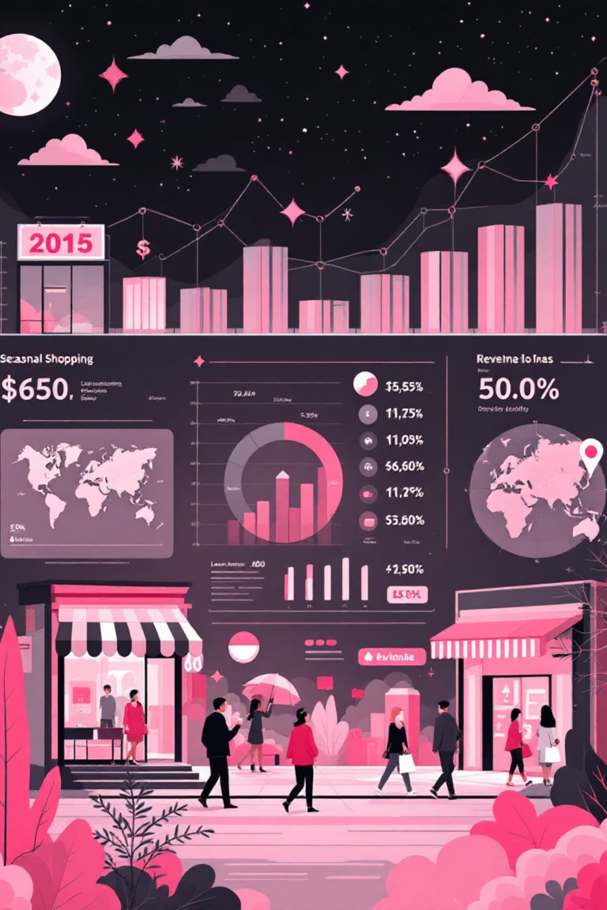





Targeted Marketing Strategy
Deal Seekers Campaigns
Deploy time-sensitive flash sales and aggressive promo code distribution through email and SMS channels
Full-Price Buyer Engagement
Showcase premium products, emphasise quality and exclusivity, offer loyalty points for sustained engagement
Subscriber Retention
Provide early access to new launches, exclusive member-only discounts, and personalised product recommendations
Cross-Cluster Opportunities
Convert Deal Seekers to subscribers through trial offers; upsell premium products to Full-Price Buyers
Location-Based Targeting
Increase marketing investment in high-potential, underperforming locations identified in analysis
Seasonal Campaign Alignment
Concentrate promotional budgets during peak seasons whilst maintaining baseline engagement year-round

Slide 19

Data-Driven Growth
This comprehensive analysis transforms raw customer data into actionable marketing strategies, enabling personalised campaigns that resonate with each customer segment whilst optimising discount strategies and maximising revenue across seasons and locations.

Slide 20
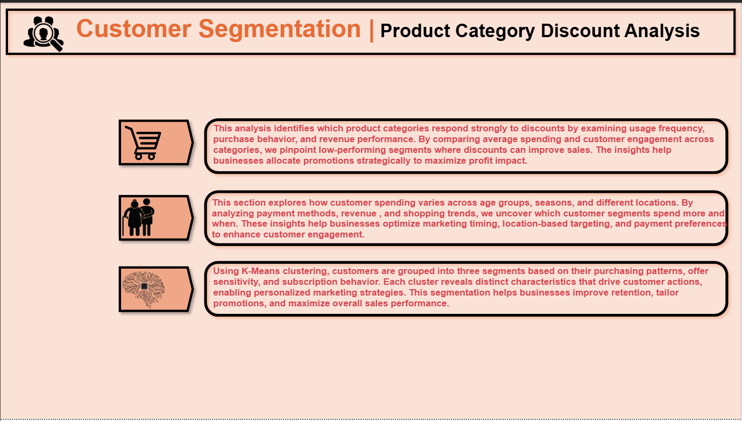
PAGE-1: Overview

Slide 21
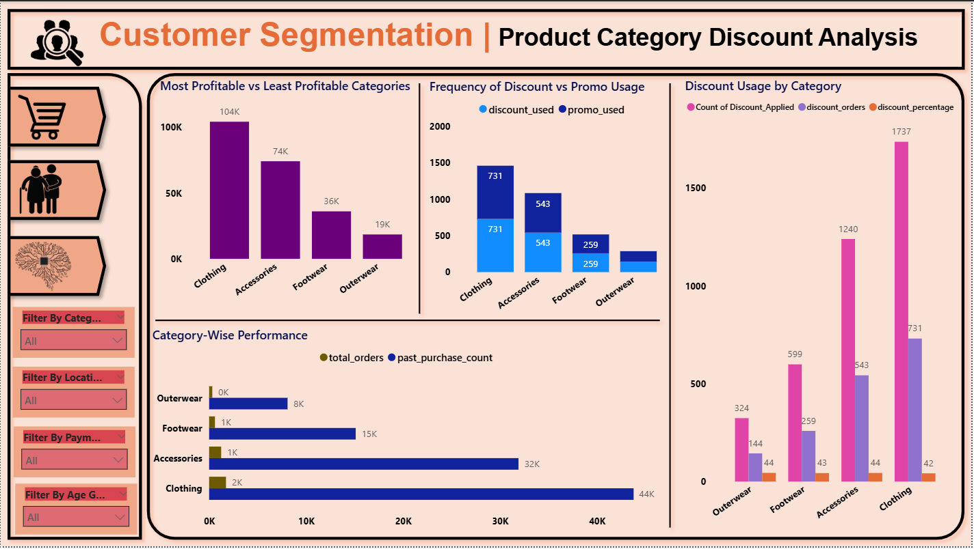
PAGE-2: Product Category Discount Analysis

Slide 22
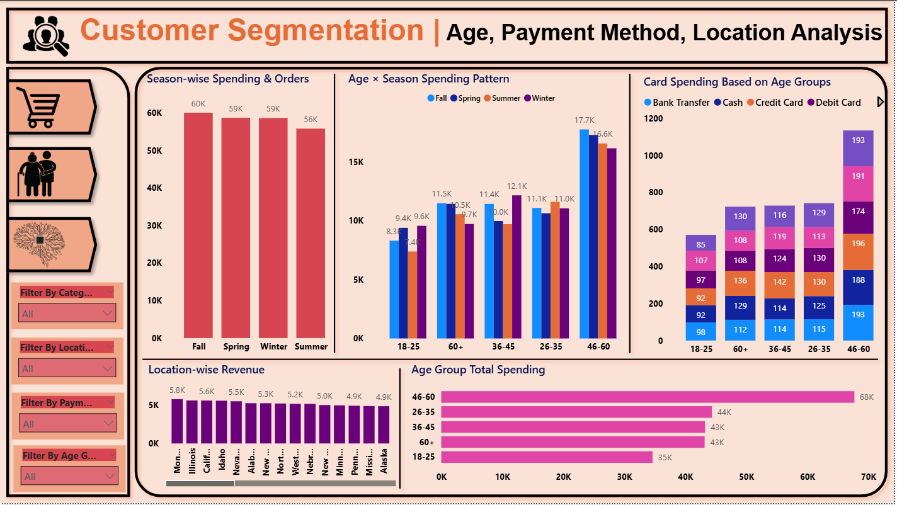
PAGE-3: Age, Season & Location Spending Analysis

Slide 23
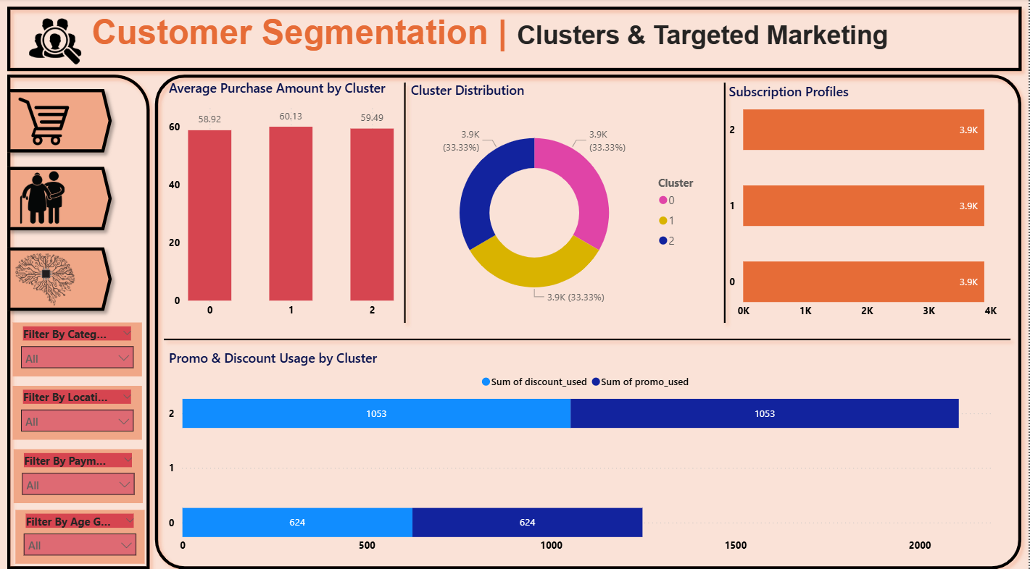
PAGE-4: Clusters & Targeted Marketing

Slide 24

Conclusion
1. The analysis revealed clear spending patterns that help the business understand which customer groups contribute most to overall revenue.
2. Category-level evaluation showed which product segments struggle without discounts and which ones perform strongly even without promotional support.
3. Season and age-based insights highlighted key periods of high spending and customer engagement.
4. Clustering created three well-defined customer segments based on purchasing patterns, loyalty behavior, and promotional responsiveness.
5. The combined SQL, Power BI, and Python analysis delivers a complete 360° view of customer behavior, empowering data-driven decisions to increase revenue, reduce costs, and enhance customer satisfaction.

Slide 25


